Slide 1
Spring 2026 Final
AERO 4720 Aircraft Design II

Slide 2




Design, Build, Fly (DBF) Lap Performance Analysis
You will analyze the performance of a R/C aircraft over the course of one lap at the Design, Build, Fly (DBF) Competition
The lap is assumed to begin with the aircraft at the start/finish line at a known state (airspeed, altitude, battery charge, etc.)
The segments are S1 (straight-line), C1 (180 deg right turn), S2 (straight-line), C2 (360 deg left turn), S3 (straight-line), C3 (180 deg right turn), S4 (straight-line to finish line)
The distance [S1+S4] = [S2+S3] = 300 m is fixed. But distances covered in turns C1, C2, and C3 are not regulated
You’re analyzing a speed run, where you want to minimize lap time
That means maintaining a high average speed throughout
In general, you want to turn tight to reduce distance C1 + C2 + C3
But be careful not to lose too much airspeed and stall in the turns!
N (${360}^{∘}$)
W (${270}^{∘}$)
E ($90^{∘}$)
C1
S ($180^{∘}$)
S1
S2
Start/Finish Line
C2
300 m
S4
S3
(not to scale)
C3

Slide 3






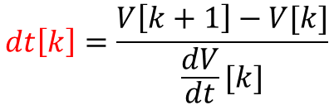








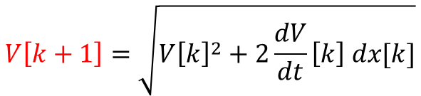





Kinematics for Straight and Curved Segments
$$k+1$$
$$k+1$$
$$x[k+1]$$
$$V[k+1]$$
$$V[k+1]$$
$$dx[k]$$
$$k$$
$$dx[k]$$
$$x[k]$$
$$V[k]$$
$$dt[k]$$
$$\frac{dV}{dt}[k]$$
$$dHDG[k]$$
$$R[k]$$
$$x[k]$$
$$V[k]$$
$$\frac{dV}{dt}[k]$$
$$dx\left[k\right]=R\left[k\right] dHDG\left[k\right] \frac{ π}{180}$$
$$k$$
For both cases:
$$V\left[k+1\right]=\sqrt{V{\left[k\right]}^{2}+2\frac{dV}{dt}\left[k\right] dx[k]}$$
$$dt\left[k\right]=\frac{V\left[k+1\right]−V[k]}{\frac{dV}{dt}[k]}$$

Slide 4
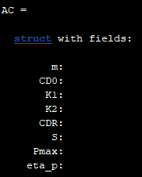
Part A: Develop Aircraft Performance Evaluator Function [20 points]
Here is the input/output form of the function call
[dhdt, dVdt, n, CL, R, PSIDOT] = CalcAircraftPerf(V, P, FPA, PHI, rho, AC)
Notice that each output from the function is one of the columns of the table that you must fill out
Outputs:
dhdt: rate of climb [m/s]
dVdt: acceleration [m/s²]
n: load factor
CL: lift coefficient
R: turn radius [m] – if going in a straight line, output inf (infinity)
PSIDOT: turn rate [deg/s]
Inputs:
V: airspeed [m/s]
P: motor shaft-power [W]
FPA: flightpath angle [deg]
PHI: bank angle [deg]
rho: air density [kg/m³]
AC: structure containing aircraft data (see → and get values from slide 6)
Concepts needed to create this function:
Excess power perf analysis for prop aircraft
Relationships between radius, turn rate, bank angle, and load factor
Relationships between climb rate, airspeed, and flightpath angle
Basic forward Euler integration

Slide 5
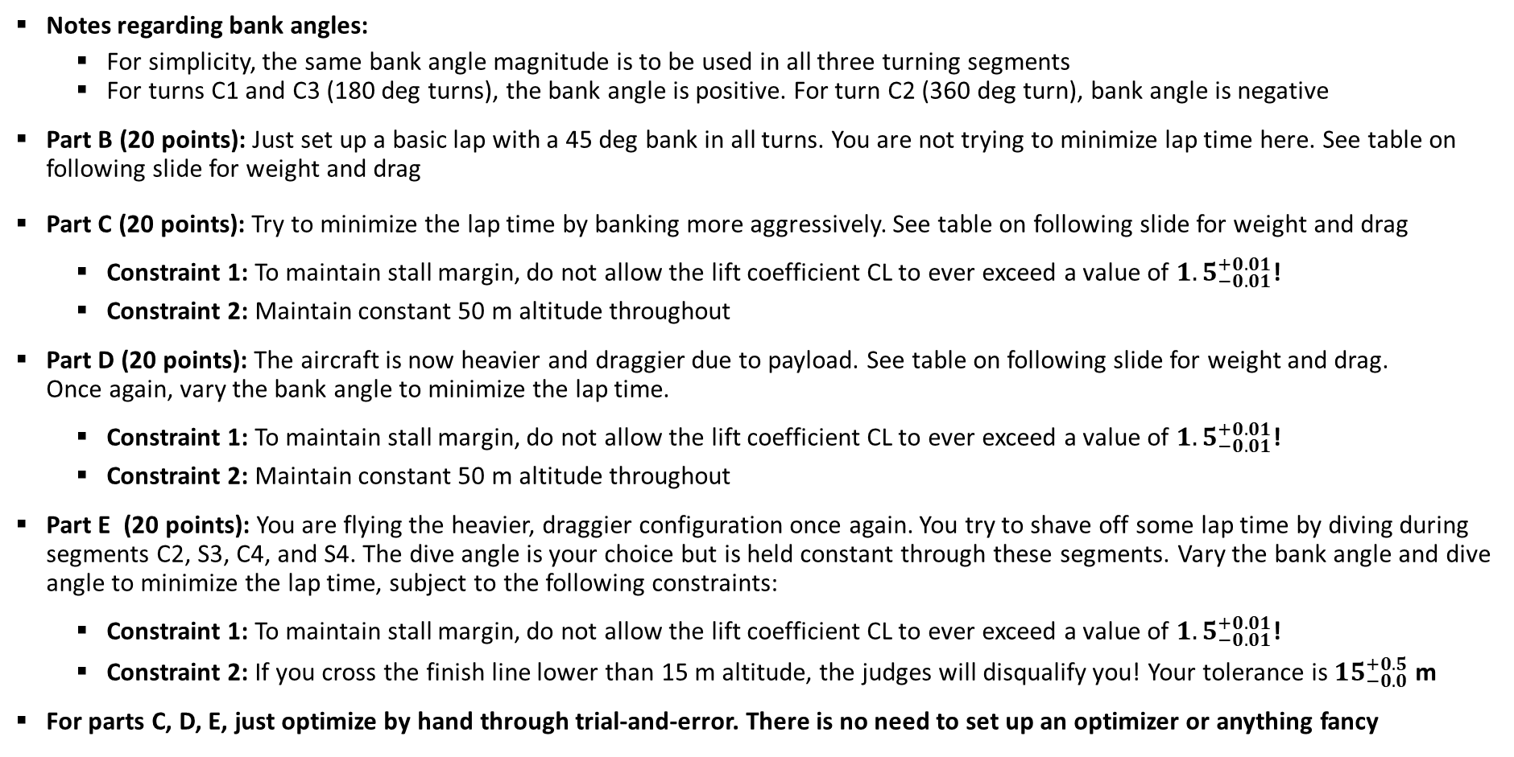
Analyze Lap Performance for the Following Scenarios
Notes regarding bank angles:
For simplicity, the same bank angle magnitude is to be used in all three turning segments
For turns C1 and C3 (180 deg turns), the bank angle is positive. For turn C2 (360 deg turn), bank angle is negative
Part B (20 points): Just set up a basic lap with a 45 deg bank in all turns. You are not trying to minimize lap time here. See table on following slide for weight and drag
Part C (20 points): Try to minimize the lap time by banking more aggressively. See table on following slide for weight and drag
Constraint 1: To maintain stall margin, do not allow the lift coefficient CL to ever exceed a value of ${1.5}_{−0.01}^{+0.01}$!
Constraint 2: Maintain constant 50 m altitude throughout
Part D (20 points): The aircraft is now heavier and draggier due to payload. See table on following slide for weight and drag. Once again, vary the bank angle to minimize the lap time.
Constraint 1: To maintain stall margin, do not allow the lift coefficient CL to ever exceed a value of ${1.5}_{−0.01}^{+0.01}$!
Constraint 2: Maintain constant 50 m altitude throughout
Part E (20 points): You are flying the heavier, draggier configuration once again. You try to shave off some lap time by diving during segments C2, S3, C4, and S4. The dive angle is your choice but is held constant through these segments. Vary the bank angle and dive angle to minimize the lap time, subject to the following constraints:
Constraint 1: To maintain stall margin, do not allow the lift coefficient CL to ever exceed a value of ${1.5}_{−0.01}^{+0.01}$!
Constraint 2: If you cross the finish line lower than 15 m altitude, the judges will disqualify you! Your tolerance is ${15}_{−0.0}^{+0.5}$m
For parts C, D, E, just optimize by hand through trial-and-error. There is no need to set up an optimizer or anything fancy

Slide 6
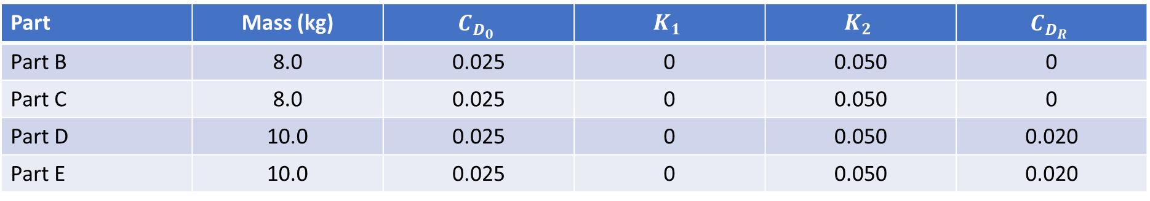
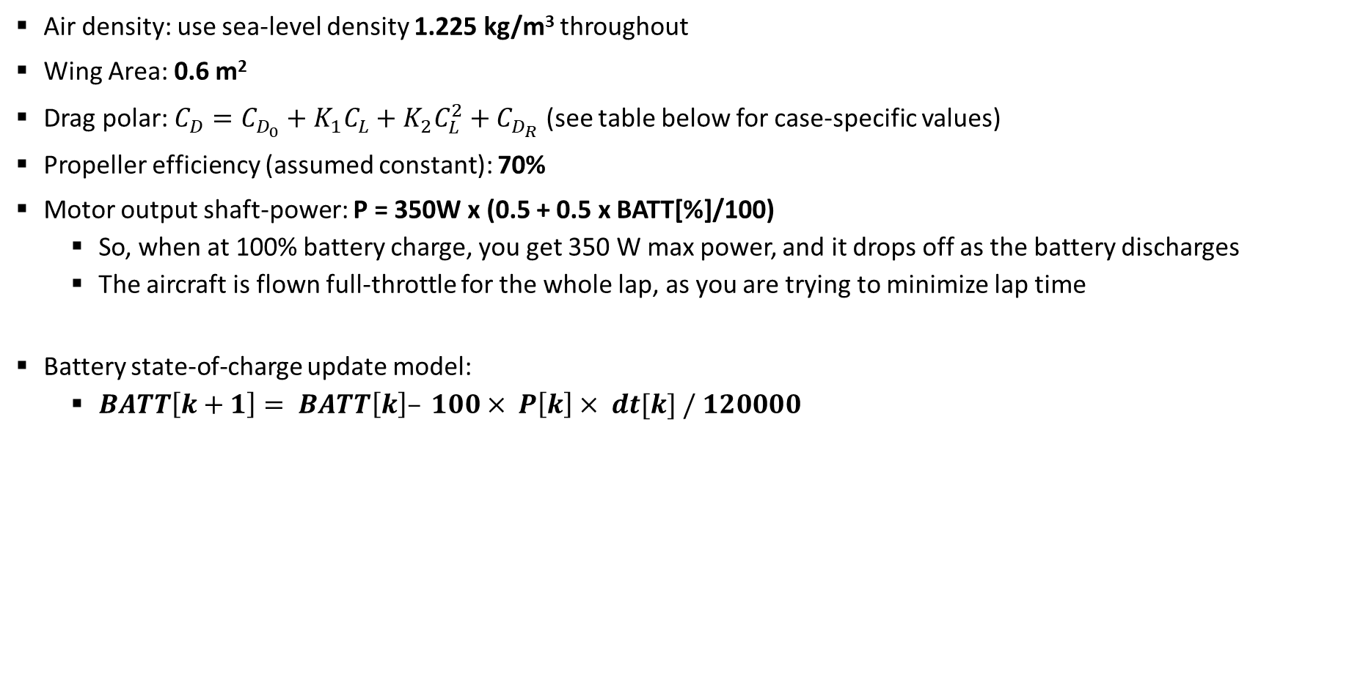
Aircraft Data for Parts B, C, D, E
Air density: use sea-level density 1.225 kg/m³ throughout
Wing Area: 0.6 m²
Drag polar: $C_{D}=C_{D_{0}}+K_{1}C_{L}+K_{2}C_{L}^{2}+C_{D_{R}}$ (see table below for case-specific values)
Propeller efficiency (assumed constant): 70%
Motor output shaft-power: P = 350W x (0.5 + 0.5 x BATT[%]/100)
So, when at 100% battery charge, you get 350 W max power, and it drops off as the battery discharges
The aircraft is flown full-throttle for the whole lap, as you are trying to minimize lap time
Battery state-of-charge update model:
$BATT\left[k+1\right]= BATT\left[k\right]– 100× P\left[k\right]× dt[k] / 120000$
Part | Mass (kg) | $$C_{D_{0}}$$ | $$K_{1}$$ | $$K_{2}$$ | $$C_{D_{R}}$$
Part B | 8.0 | 0.025 | 0 | 0.050 | 0
Part C | 8.0 | 0.025 | 0 | 0.050 | 0
Part D | 10.0 | 0.025 | 0 | 0.050 | 0.020
Part E | 10.0 | 0.025 | 0 | 0.050 | 0.020

Slide 7
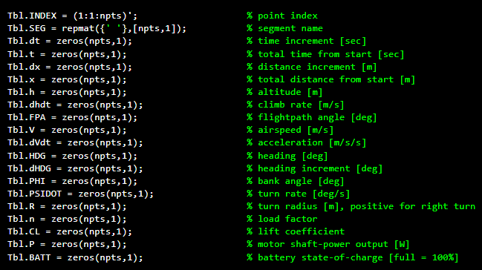
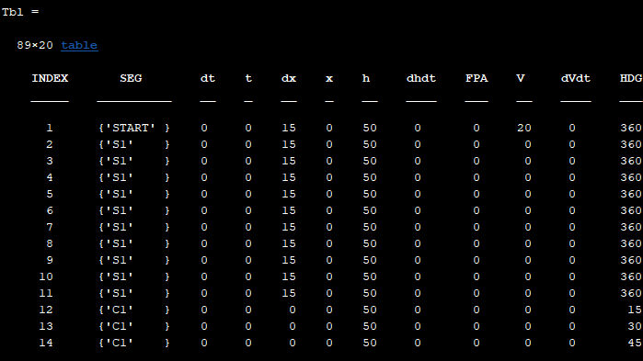
Instructions
For Parts B, C, D, and E, execute the LapTblCreator.m file to get the performance table in the correct format (below)
All columns and their units are defined in this file. Read them carefully!
Straight line segments have already been discretized in terms of distance dx
Turn segments have already been discretized in terms of heading increment dHDG
Use the CalcAircraftPerf.m function you created to fill in the rows and columns of the table
You are trying to minimize the total time t at the end of the lap (last row of the table – “FINISH”)

Slide 8
Sanity Check: State of the Aircraft at the Finish Line for Part B

